Slide 1

The Highlights

Slide 2






Team Highlights
Name | Location
Aanchal Lohia | Mumbai, India
Ravishekhar Gopalan | Toronto, Canada
Chetan Urkudkar | Dublin, USA
Pankaj Khairnar | Mumbai, India
Prashant Hattiholi | Pune, India

Slide 3
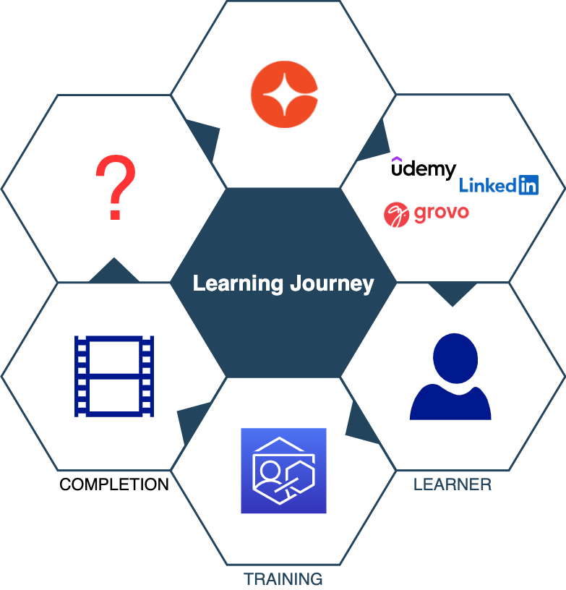
Learning Journey
Notes:
Cornerstone provides world class content to its customers with the help of content providers CCA, grovo, linked in learning ,udemy.
The content is surfaced to learners via our recommendation engine.
The content is consumed by learner but overtime how much is it retained??

Slide 4
Completion is a milestone!
Notes:
Even though completion is a milestone , if you don’t use what you have learnt , you lose it .

Slide 5


From
Retention Burden
To
Ease of access

Slide 6
Problem
Learning Retention
Notes:
After one hour, people retain less than half of the information presented. · After one day, people forget more than 70 percent of what was learnt.

Slide 7
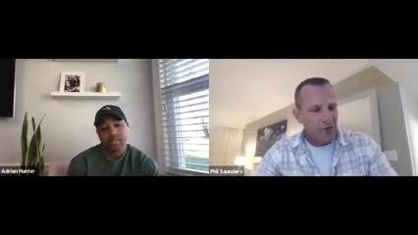
How do we solve it?

Slide 8
Demo

Slide 9
Key Benefits
Product Agnostic
No Cost Development
Improves Social Engagement

Slide 10
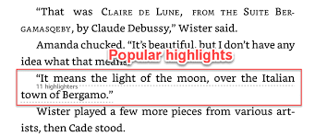

Road Map

Slide 11
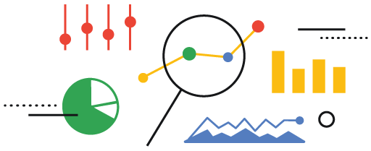
Data insights into the most highlighted content
For day, week, subject, content categories etc.

Slide 12
Questions?
cornerstoneondemand.com
Team Highlights
highlights@csod.com

Slide 13
Thank You!

